Slide 1
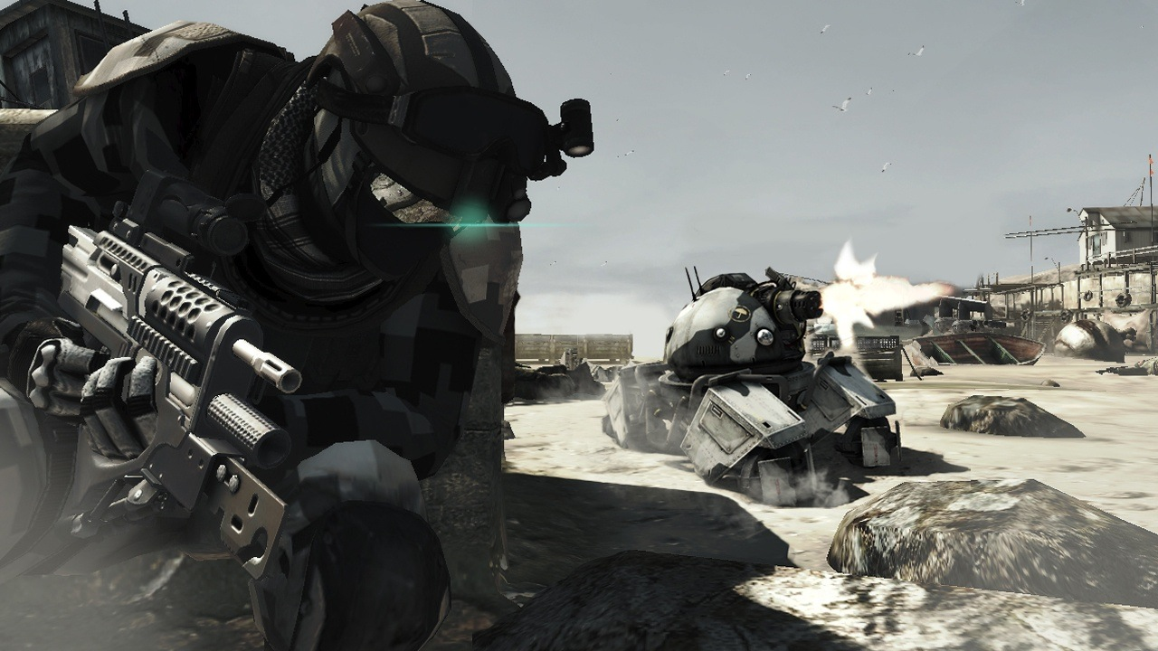
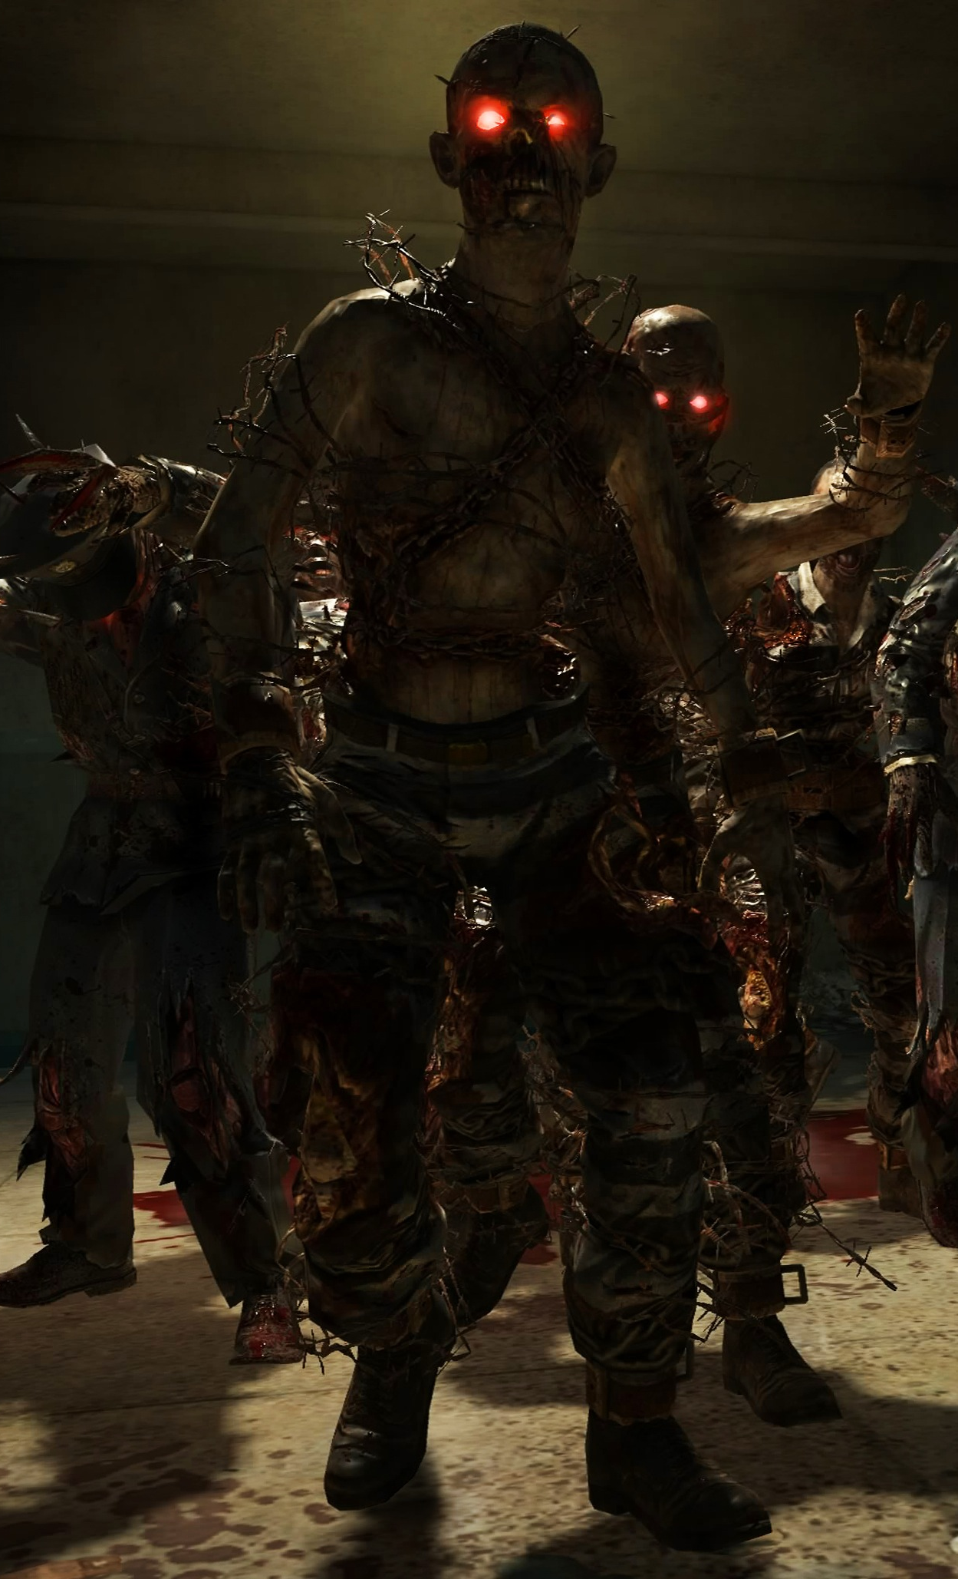
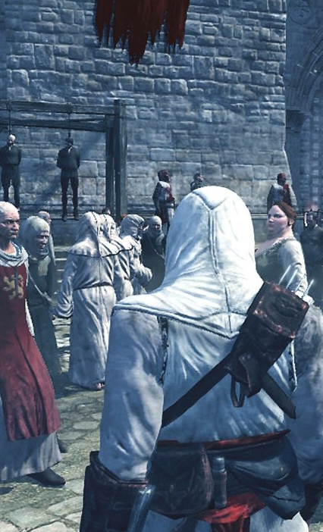
AI for Games
ICP2025 | ICP 3025 | ICP4152
Lecture 10 : Exam Revision

Slide 2
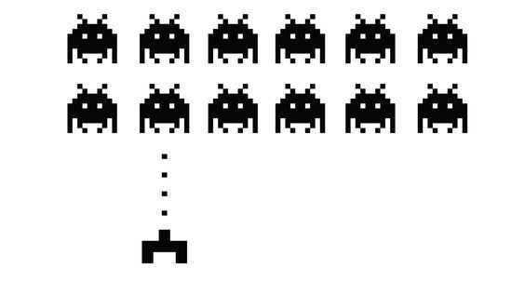
Lectures
Week 1 : Introduction
Week 2 : Role of the AI
Week 3 : Reactive Agents Part I
Week 4 : Reactive Agents Part II
Week 5 : Navigation and Search
Week 6 : Artificial Stupidity
Week 7 : Learning and Evolution
Week 8 : No Lecture
Week 9 : Procedural Animation + New Tech
Week 10 : No Lecture
Week 11 : Exam Revision + Assignment Marking
Week 12 : Assignment Marking

Slide 3

Assignment Marking
Deadline for project submission was yesterday
Blog deadline is 16th December @ 23:59pm
Marking in the labs this week and next

Slide 4
Assignment Marking
There are 5 lab sessions where you can get your work assessed:
Monday 2nd December 2-4pm (DS_207)
Wednesday 4th December 9-11am (DS_207)
Friday 6th December 2-4pm (DS_319)
Monday 9th December 2-4pm (DS_207)
Wednesday 11th December 9-11am (DS_207)

Slide 5
Assignment Marking Procedure
Very similar to the formal feedback session
Demonstrate your project and answer questions
Only a preliminary look, I will formally mark you when I look at the code and blog too
Note: You won’t know your marks until finalised!

Slide 6
Assignment Marking Procedure
It will take me a while to get through everyone
Please be patient / respectful of others
Once you’ve been marked you are free to leave
No formal attendance will be recorded

Slide 7
Blog Marking
There are still two weeks until Blog deadline!
Blog marking scheme on Blackboard
Remember screenshots, videos, references
ICP3025 remember to write an article on novel AI technologies:

Slide 8
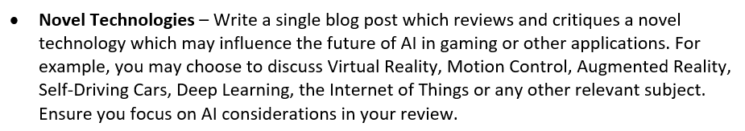
Reminder for ICP3025
For ICP3025, one requirement for the blog is to write a short article about a novel technology that will influence the future of AI in Games or other Applications:
No specific word count, but 500-1000 words is a good target
Remember to include references at the end of the article

Slide 9
The Exam

Slide 10
Mark Breakdown
ICP-2025
ICP-3025
Assignment: 70%
Game Implementation: 45%
Blog : 25%
Exam: 30%
Assignment: 50%
Game Implementation: 25%
Blog : 25%
Exam: 50%

Slide 11
Past exam papers
Past exam papers are on Blackboard 2016-2019
Questions will be different depending on degree programme

Slide 12

Exam Basics
Format of exam this year is “Answer ALL Questions”
Different to < 2018, which were answer 2/4
You will have 1½ hours
Questions are a mixture of short answer (a,b,c,d) and short essay
Examples of both types of question can be seen in past exam papers…

Slide 13
Exam Topics
The topics covered in the exam line up with the lecture topics:
The Role of the AI
Reactive Agents
Navigation and Search
Artificial Stupidity
Learning and Evolution
Procedural Animation
New Technologies

Slide 14
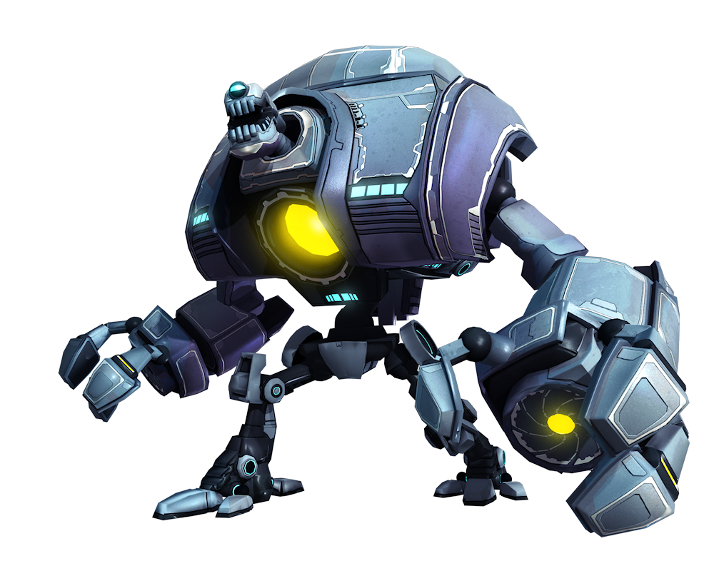
Topic: Role of the AI
The 5 Roles of AI
The AI as an Opponent
The AI as a Team Mate
The AI as a Director
The AI as Scenery
The AI as Architect
Examples of each

Slide 15
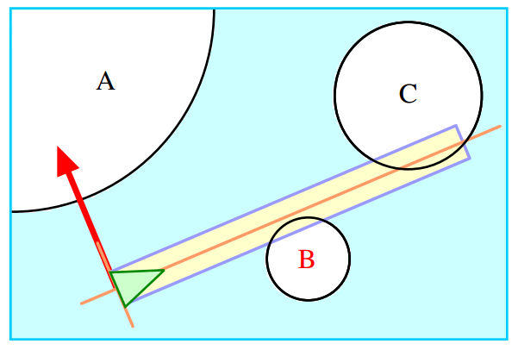
Topic: Reactive Agents
Braitenberg Vehicles
Steering Behaviours
3 Layer Model
Seek and Flee
Purse and Evade
Wander
Arrival
Obstacle Avoidance
Combinational Behaviours
Sensing
Finite State Machines (FSM + HFSM)
Behaviour Trees

Slide 16
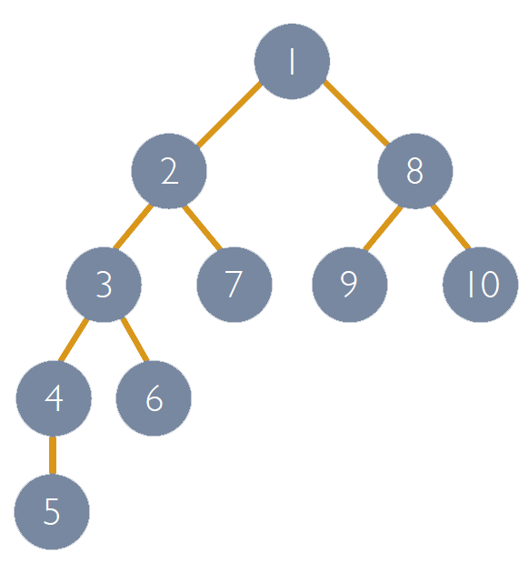
Topic: Navigation and Search
Pathfinding
Search Algorithms
Uninformed Search
Informed Search
Adversarial Search
A* Search and Waypoints
Navigation Mesh
Reactive Path following
Depth first search – numbers show order nodes are visited

Slide 17
Topic: Navigation and Search
Artificial Stupidity
Rules of Believable AI
Being Stupid
Rubber Banding
Reaction Time
Terrible Aim
Kung-Fu Attacks
etc.

Slide 18
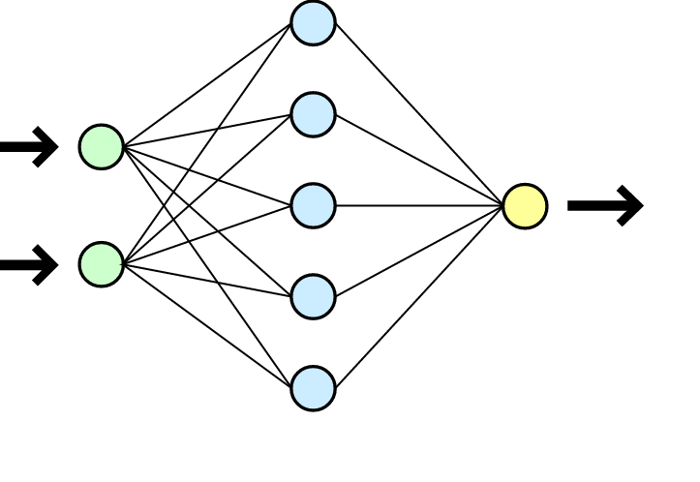
Topic: Learning and Evolution
Learning
Offline Learning
Neural Networks
Online Learning
Reinforcement Learning
Evolution
Genetic Algorithms
Genetic Programming
Template Based Evolution
Morphology Evolution

Slide 19
Topic: Procedural Animation
Data-driven Animation
Key-Frame animation
Motion capture
Procedural Animation
Kinematic Animation
Dynamic Animation
Neural Network control
Boids

Slide 20
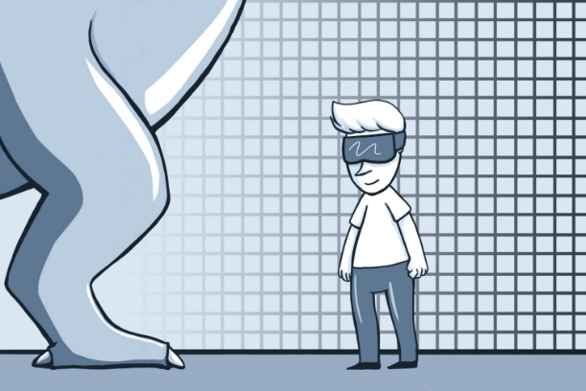
Topic: New Technologies
Virtual Reality
Augmented Reality
Hand + Body Tracking
Presence
AI interaction
Volume
Personal Space
Eye Contact
Hand Gestures etc.

Slide 21
End of Lectures
Thanks and good luck!

